Slide 1
Gender Recognition Using Voice Dataset by Machine Learning
Notes:
1

Slide 2
Course:CSE498R Faculty:Dr. Mohammad Monirujjaman Khan
Submitted By:
Taslima Akter Tonny 1821670042
Shahida Akter Chowdhury 1811205642
Kanish Fatama Shraboni 1821220042
Sifat Anwar 1812887642
Notes:
1

Slide 3
OUTLINE
1
3
5
Abstract
Dataset
Conclusion
2
4
Tools
Results and Analysis

Slide 4
Abstract
In this project, we are offering gender recognition using voice dataset by machine learning algorithm. Here the machine learning predicting models like Logistic Regression, Gradient Boosting Classifier, AdaBoost Classifier, K-Nearest Neighbor and Multi-Layer Perceptron Classifier techniques are used. In this article, we've examined 3168 data from both males and females. Our predicting model such as Logistic Regression, Gradient Boosting Classifier, AdaBoost Classifier, K-Nearest Neighbor and Multi-Layer Perceptron Classifier showed the accuracy 98%, 98%, 98%, 97%, and 97% respectively. It was found that the logistic regression, gradient boosting classifier, and adaboost classifier models had the highest accuracy (98%).

Slide 5





Tools
The software tools we are using in this project–
Libraries we need to execute this model-

Slide 6
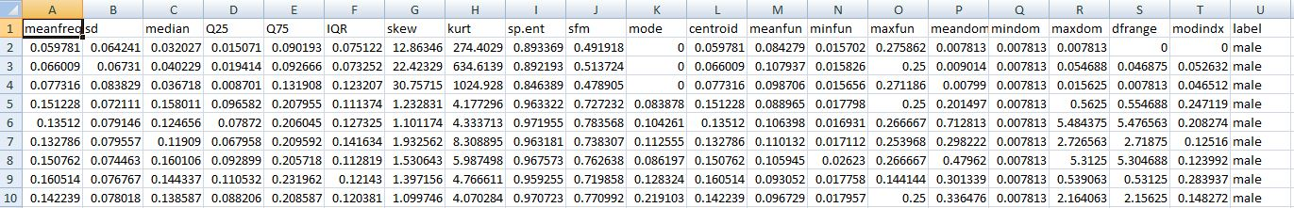
Dataset
The dataset which is used in this project is based on CSV file. Our dataset is publicly available. The dataset includes 3168 samples of both male and female voices with voice acoustic properties. Meanfreq, mode, sd, median, q25, q75, skew, iqr, kurt, sp.Ent, meanfun, minfun, centroid, maxfun, mindom, sfm, meandom, maxdom, dfrange, modindex, and label are the acoustic qualities.

Slide 7
Results and Analysis
Model Accuracy:
In this study, we have compared several machine learning models using voice dataset. We took 80% random data for training and 20% random data for testing. Logistic regression, gradient boosting classifier, adaboost classifier, k-nearest neighbor and multi-layer perceptron classifier (MLPclassifier) algorithms were used to identify the gender, and their respective accuracies were 98%, 98%, 98%, 97%, and 97%.

Slide 8
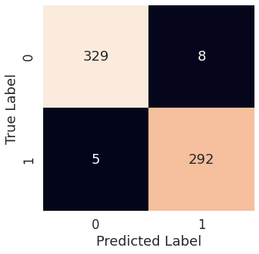
Results and Analysis
Confusion Matrix:
In the confusion matrix, the genders are represented by 1 for the female and 0 for the male.
In Logistic Regression algorithm, total correct predicted result is 621 data. The correct male voice recognition result is 329 data and the correct female voice recognition result is 292 data.
Figure 1: Confusion Matrix (Logistic Regression)

Slide 9

Results and Analysis
Confusion Matrix:
In Gradient Boosting Classifier algorithm, total correct predicted result is 623 data. The correct male voice recognition result is 329 data and the correct female voice recognition result is 294 data.
Figure 2: Confusion Matrix (Gradient Boosting Classifier)

Slide 10

Results and Analysis
Confusion Matrix:
In AdaBoost Classifier, total correct predicted result is 621 data. The correct male voice recognition result is 331 data and the correct female voice recognition result is 290 data.
Figure 3: Confusion Matrix (AdaBoost Classifier)

Slide 11
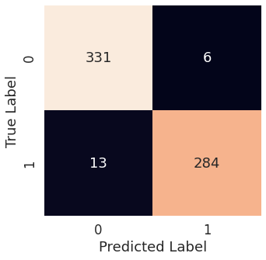
Results and Analysis
Confusion Matrix:
In K-Nearest Neighbor, total correct predicted result is 615 data. The correct male voice recognition result is 331 data and the correct female voice recognition result is 284 data.
Figure 4: Confusion Matrix (K-Nearest Neighbor)

Slide 12
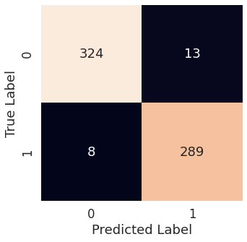
Results and Analysis
Confusion Matrix:
In Multi-Layer Perceptron Classifier, total correct predicted result is 613 data. The correct male voice recognition result is 324 data and the correct female voice recognition result is 289 data.
Figure 5: Confusion Matrix (Multi-Layer Perceptron Classifier)

Slide 13
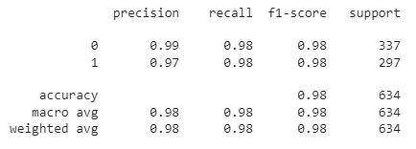
Result and Analysis
Model Evaluation:
In Logistic Regression algorithm, precision, recall, f1-score respective results were 0.99, 0.98, 0.98 for male and 0.97, 0.98, 0.98 for female.
Figure 6: Classification Report (Logistic Regression)

Slide 14
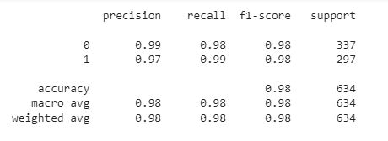
Result and Analysis
Model Evaluation:
In Gradient Boosting Classifier algorithm, precision, recall, f1-score respective results were 0.99, 0.98, 0.98 for male and 0.97, 0.99, 0.98 for female.
Figure 7: Classification Report (Gradient Boosting Classifier)

Slide 15
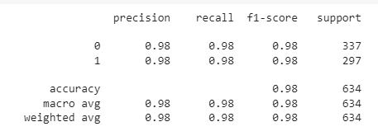
Result and Analysis
Model Evaluation:
In AdaBoost Classifier algorithm, precision, recall, f1-score respective results were 0.98, 0.98, 0.98 for male and 0.98, 0.98, 0.98 for female.
Figure 8: Classification Report (AdaBoost Classifier)

Slide 16
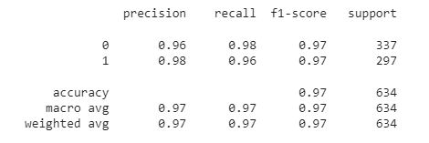
Result and Analysis
Model Evaluation:
In K-Nearest Neighbor algorithm, precision, recall, f1-score respective results were 0.96, 0.98, 0.97 for male and 0.98, 0.96, 0.97 for female.
Figure 9: Classification Report (K-Nearest Neighbor)

Slide 17
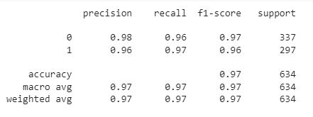
Result and Analysis
Model Evaluation:
In Multi-Layer Perceptron Classifier algorithm, precision, recall, f1-score respective results were 0.98, 0.96, 0.97 for male and 0.96, 0.97, 0.96 for female.
Figure 10: Classification Report (Multi-Layer Perceptron Classifier)

Slide 18
Conclusion
The primary goal of this research was to create a speech signal-based gender recognition system. The dataset for this project was collected from kaggle. We evaluated at 3168 records from both males and females. To improve the accuracy of the experiment, we compare five different algorithms. In this study, gender recognition from audio data is presented using logistic regression, gradient boosting classifier, adaboost classifier, k-nearest neighbor (KNN), and multi-layer perceptron classifier (mlpclassifier), with respective accuracies of 98%, 98%, 98%, 97%, and 97% and compare them in terms of F1 score, recall, and precision. In this model, logistic regression, adaboost classifier, and gradient boosting classifier produced the best results.

Slide 19
Thank You

